Slide 1

Machine Learning for Cyber Security
Week 11
Mesut GUVEN, Ph.D.

Slide 2
information
Exams; 55% (Mid 25% + Final 30%), Homeworks; 15%, Project; 30%
In homeworks, you will be expected to examine SCI/E papers (published in last 3 years).
In Final Project, you will implement an AI/ML-based cyber solution.
Textbook:
- Getting Started with Deep Learning: Programming and Methodologies using Python
- Hands-On Machine Learning with Scikit-Learn, Keras, and TensorFlow, 2nd Edition
Code: GitHub
Videos: YouTube

Slide 3
UNIT 11: static malware code analyse with tokenized inputs
Learning Outcomes;
- have a better understanding for static malware analysis by using tokenized assembly codes as input to a DL model.

Slide 4
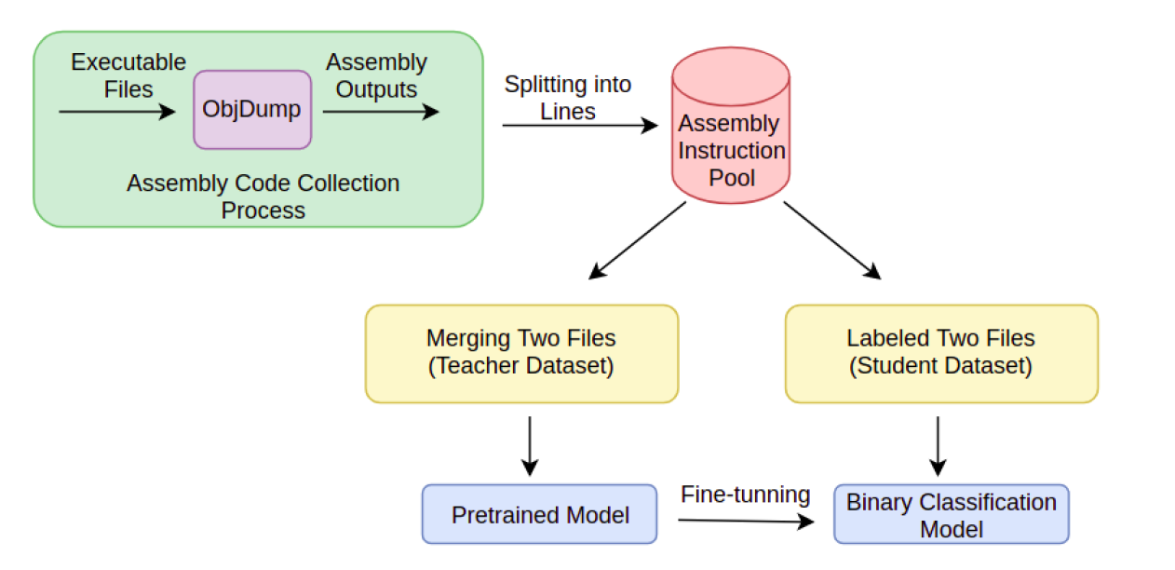
malware analysis with assembly and tokenization [1]
“from tokenizers import ByteLevelBPETokenizer” is used for tokenization.
“from transformers import LineByLineTextDataset” splits data into chunks,
“from transformers import DataCollatorForLanguageModeling” pad inputs to same size.
“from sklearn.metrics import accuracy_score, classification_report” used for displaying metrics.
“from Transformers Import GPT2ForSequenceClassification” is a transformer-based model for a sequence classification using the last token to do the classification.

Slide 5
UNIT 11: static malware code analyse with tokenized inputs
MALWARE DETECTION USING TRANSFORMERS-BASED MODEL GPT-2
Nazenin Sahin (M.S., Department of Cyber Security) will present the implementation and perform the lab session.

